Slide 1
E-Commerce
Computer Systems Management
Module Code CT012-3-3

Slide 2
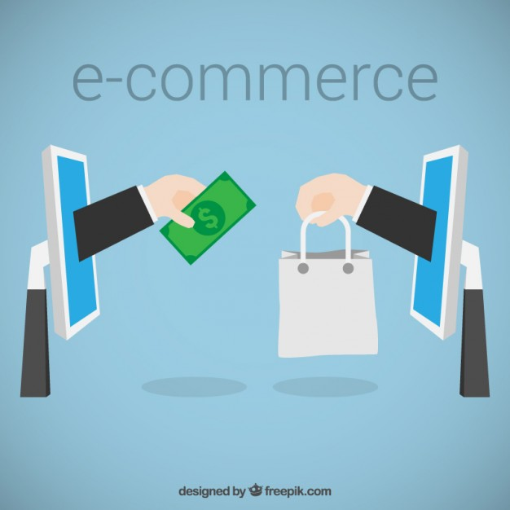
Learning Outcomes
Electronic Business (E- Business)
Electronic Commerce (E-Commerce)
Secure Transmission

Slide 3
Content
E- Business
E-Commerce
Evolution of Electronic Commerce
Categories of Electronic Commerce
Electronic Business Drivers
Electronic Business Elements
Secure Transmission

Slide 4
Key Terms
E- Business
E-Commerce
Secure Transmission

Slide 5
Electronic Business and Electronic Commerce
E-Business
  Conducting business using telecommunications network esp. Internet. More than buying and selling e.g servicing customers online, collaborating with partners and suppliers, R&D
E-Commerce (An aspect of e-business)
  Conducting commerce (buying and selling) electronically using the Internet
Dot-com (pure dot-com)
  Business operating only online
Bricks and Clicks
Business operating online + physical store
Bricks and Mortar
Business operating only via physical store

Slide 6
Evolution of E-Commerce
Late 1990s: few companies doing buying or selling online
  Amazon, EBay establishing footholds
1998: Google search engine established
  Provides relevant search results than existing search engines
  One of the most successful online companies today

Slide 7
Evolution of E-Commerce
E-Commerce History
  Internet-led rapid growth mid-1990s to 2000
  2000 “Dot-com boom” followed by “Dot-com bust”
  2000 to 2003 Overly gloomy news reports
  2003 Sales and profit growth return
    e-commerce becomes part of general economy
  2008 general recession
    e-commerce hurt less than most of economy
    US, Europe affected largely, large Asian economies (China, India) less affected and continued to expand
  From 2003 to the present
    e-commerce expanded more in good times and contracted less in bad times

Slide 8
Categories of Electronic Commerce
Business-to-consumer (B2C)
  Consumer shopping on the Web
2. Business-to-business (B2B)
  Transactions conducted between businesses
  Supply management (procurement) departments
    Negotiate purchase transactions with suppliers
3. Business processes
  Companies, governments use Internet technologies to support buying and selling. Logical activities e.g.
  purchasing raw materials, managing transportation and logistics, hiring and training employees

Slide 9
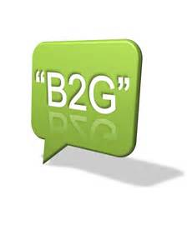
Categories of Electronic Commerce
4. Consumer-to-consumer (C2C)
  Individuals buying and selling among themselves
    Web auction site
5. Business-to-government (B2G)
  Business transactions with government agencies
    Paying taxes, filing required reports

Slide 10
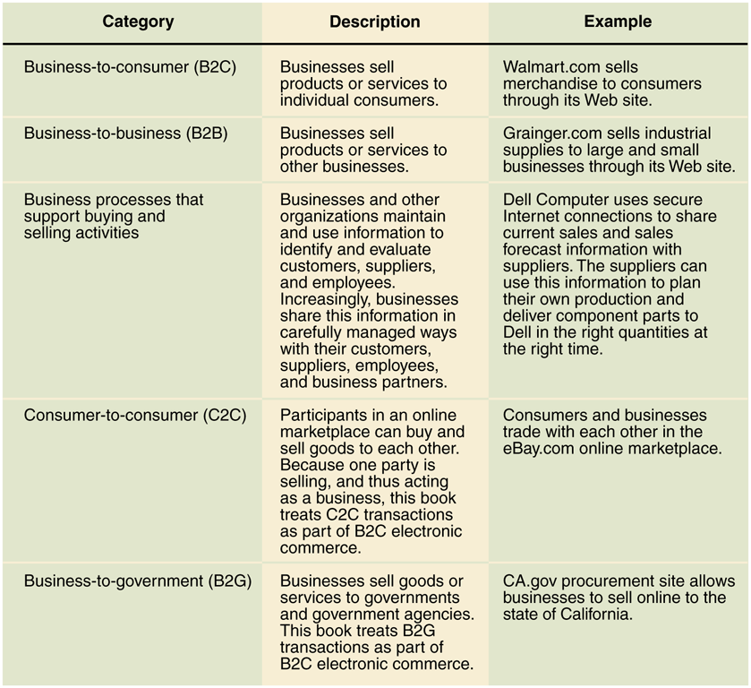
Categories of Electronic Commerce

Slide 11
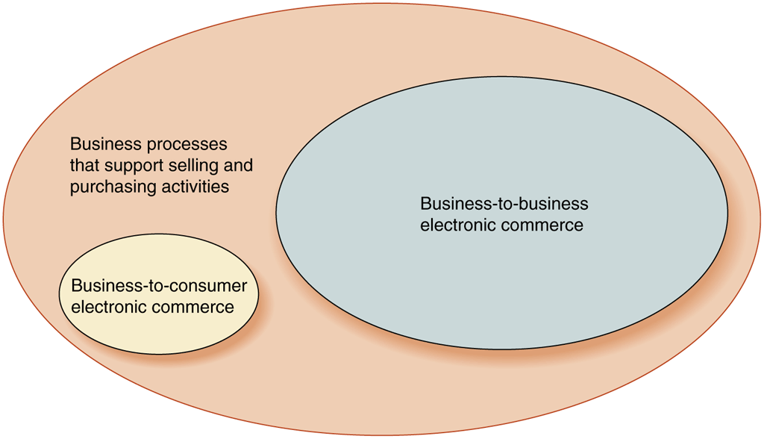
Relative Size of Electronic Commerce Elements

Slide 12
Electronic Business Drivers
Key components that accelerated rapid growth and acceptance of e-business
1. Wide access to public network
  Public network - network where anyone can connect e.g. Internet
  Private network - network to which access is restricted e.g. corporate or school network
2. Internet Technology
TCP/IP reduces network, implementation and training costs

Slide 13

E-Business Drivers
3. Standard user interface
Browsers to connect to the Internet
4. E-Business applications
Runs on the Internet, drastically reducing access and communications costs

Slide 14
Electronic Business Benefits
Global accessibility – Internet reduces
geographical constraints
Reduced order processing – efficiency through automated processing
Greater availability 24/7 – available 24 hours
Closer Customer relationship – quick to address concerns and customize responses
Increased customer loyalty – customer service + personalized attention generates loyalty
New products and services – direct link to customer provides instant info on products
Direct marketing – manufacturers bypass retailers, distributors and sell direct to customers

Slide 15
Electronic Commerce Barriers
Poor choices for electronic commerce e.g.
  perishable foods, high-cost, unique items
Need for critical mass of customers with appropriate technology
Unpredictability in costs and revenues
Insufficient tools for hardware and software integration
Cultural and legal barriers
Security mechanism for payments

Slide 16
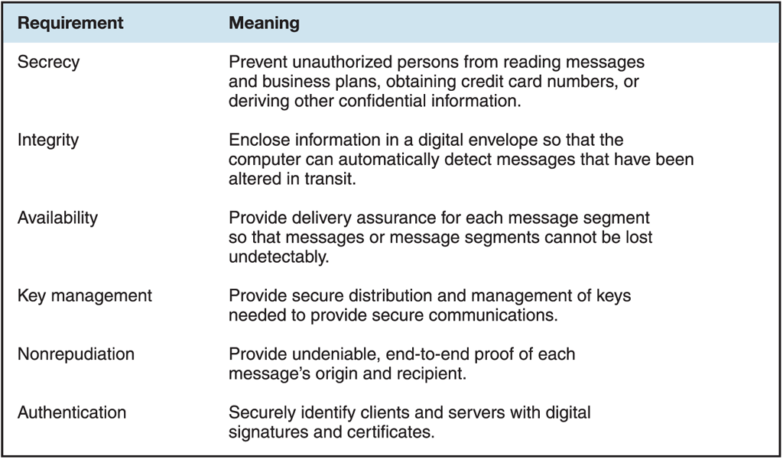
Secure Electronic Commerce Requirements

Slide 17
Summary
Question and Answer Session
  Electronic Business - conducting business using telecommunications network esp. Internet. More than buying and selling e.g servicing customers online, collaborating with partners and suppliers, R&D
  Electronic Commerce - conducting commerce (buying and selling) electronically using the Internet
  Benefits - global accessibility, reduced order processing, greater availability 24/7, closer customer relationship, increased customer loyalty, new products and services, direct marketing

Slide 18
Review Questions
Question and Answer Session
Explain the categories of e-Commerce
Describe what is meant by secure transmission

Slide 19

Question and Answer Session
Question and Answer Session
Q & A

Slide 20
What We will Cover Next
Question and Answer Session
Summary

